Slide 1
Microsoft Project 2007
Further on tasks

Slide 2

Course Objectives
Defining finer details of tasks for optimum use of scheduling engine
  Specifying task constraints
  Changing task types
  Tasks on Critical Path/ Critical Tasks
  Create a task calendars
  Set deadlines for milestone tasks
  Schedule recurring tasks
  Splitting tasks to interrupt work

Slide 3
Specifying Task Constraints and Task Types
Effect of constraints on schedule
Categories and types of constraints
Task types & effect of task types on schedule
Identify tasks on the critical path
Review task types and task constraints.

Slide 4
Effect of Constraints on Schedule
Task Constraints
  External factors that can restrict the start and end dates of tasks.
Categories of Constraint
  Flexible
    Flexible constraints do not impose restrictions on the start and end dates of a task. The task can begin as soon as the predecessor task is completed. If a task has no dependencies or lag specified, the project start date will be the start date of the task.
  Semi-flexible
    Semi-flexible constraints require that the task be started or completed either before or after the specified date. Applying semi-flexible constraints can create a lead or a lag because the successor task cannot begin before the specified date, even if the predecessor task is completed early.
  Inflexible
    Inflexible constraints supersede all other scheduling parameters and can cause a lead or a lag. Delays in dependent tasks or changes in the schedule do not impact the scheduling of a task with an inflexible constraint.
By default task constraints override task relationships. You can change it in options

Slide 5
Types of Constraints
Flexible constraints
  As Soon As Possible (ASAP)
  As Late As Possible (ALAP)
Semi-flexible constraints
  Start No Earlier Than (SNET)
  Finish No Earlier Than (FNET)
  Start No Later Than (SNLT)
  Finish No Later Than (FNLT)
Inflexible constraints
  Must Start On (MSO)
  Must Finish On (MFO)

Slide 6
Task Types and Schedule
Three factors affect task scheduling
  Duration - Time required to complete a task
  Work - Effort required to complete a task
  Units - People or material available to perform a task
Duration = Work/Units
The tasks can be categorized into the following three task types:
  Fixed units – Availability of resources remains constant
  Fixed work - Effort required for the task remains constant
  Fixed duration - The calendar time required for the task remains constant
The default task type is fixed units.

Slide 7
Effect of Task Types on Schedule
Duration = Work/Units
When units are fixed
    If you change the units, the duration is recalculated.
    If you change the duration, the work is recalculated.
    If you change the work, the duration is recalculated.
When work is fixed
    If you change the units, the duration is recalculated.
    If you change the duration, the units is recalculated.
    If you change the work, the duration is recalculated.
When duration is fixed
    If you change the units, the work is recalculated.
    If you change the duration, the work is recalculated.
    If you change the work, the units is recalculated

Slide 8
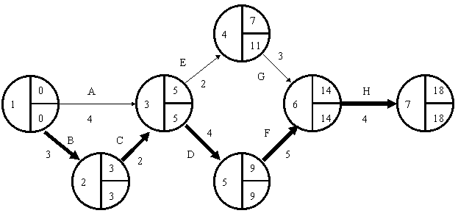
Tasks on the Critical Path
The task relationships determine the sequence in which the tasks are performed and the period of time for which a task can be delayed without impacting its successor tasks. This time period is called free slack. A task that has zero free slack is on the critical path because any delay in the start of the task impacts the end date of the project
You can assess the risks to the project schedule by tracking the progress and status of the critical tasks.

Slide 9
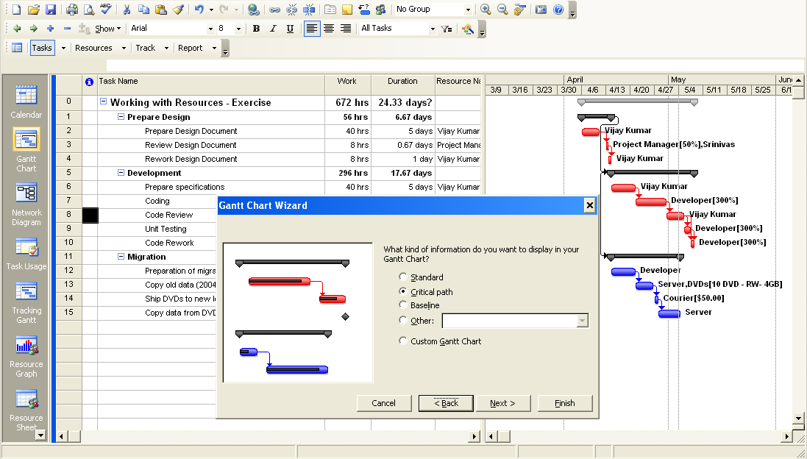
Highlighting Critical Path

Slide 10
Highlighting Critical Path
You can choose to view only the critical path. Alternatively, you can select the Custom Gantt Chart option to view additional information, such as the slack and the baseline, along with the critical path
Procedure
  On the Format menu, click Gantt Chart Wizard.
  Click Next.
  Under “What kind of information do you want to display in your Gantt Chart?”, select Critical path, and then click Next.
  Under “What task information do you want to display with your Gantt bars?”, Select the Resources and dates option and then click Next.
  Under “Do you want to show link lines between dependent tasks?”, Select Y and click Next.
  Click Format It and then click Exit Wizard.

Slide 11
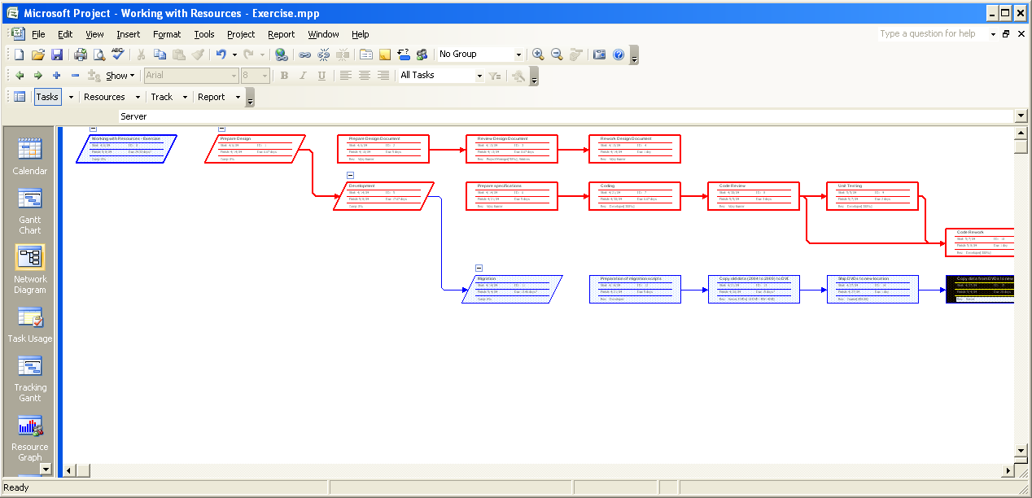
Critical Path

Slide 12
Questions
Due to delay in some of the tasks in your project, the project end date has been delayed by a week. You need to take corrective action to ensure that the project finishes at the scheduled end date. Which of the following actions should you perform to get the project back on track?
Select the best answer.
  Identify the tasks that have a higher duration than the other tasks and reduce the duration of these tasks.
  Remove all semi-flexible and inflexible constraints to ensure that all tasks are scheduled to begin as soon as possible.
  Identify the tasks on the critical path and focus on reducing their duration.
  Advance the start dates of all the successor tasks.
  ✓

Slide 13
Questions
You want to schedule the testing task to begin after the testing environment is set up. Which of the following constraints should you apply to the testing task?
Select the one best answer
  The SNET constraint
  The MSO constraint
  The ALAP constraint
  The SNLT constraint
  ✓

Slide 14
Questions
You have applied the MFO constraint to a task, which is set as a milestone. The predecessor task was completed three days earlier than planned. Which of the following changes will you see in the schedule after you update the actual end date for the predecessor task?
Select the one best answer
  The milestone task will finish three days earlier.
  The project will finish three days earlier.
  A scheduling conflict will occur.
  The schedule will not change
  ✓

Slide 15
Creating a Task Calendar
You may want to create a task that does not follow standard project calendar. For example, a task needs to be completed by working 4 hours in evening due to available time slot or required weekend working
  You can create a new task calendar by using the any existing or project calendar
  After you have created the new task calendar, specify the working days and the working hours for the task calendar.
  Once task calendar is created, you can apply the new task calendar to a specific task by modifying the task properties in the Task Information dialog box.
  When you apply the new task calendar, it overrides the default Standard calendar.
  When you select the Scheduling ignores resource calendars check box, the task calendar takes precedence over the resource calendar of the resources that are assigned to the task.
  The new task calendar is now applied to the selected task.

Slide 16
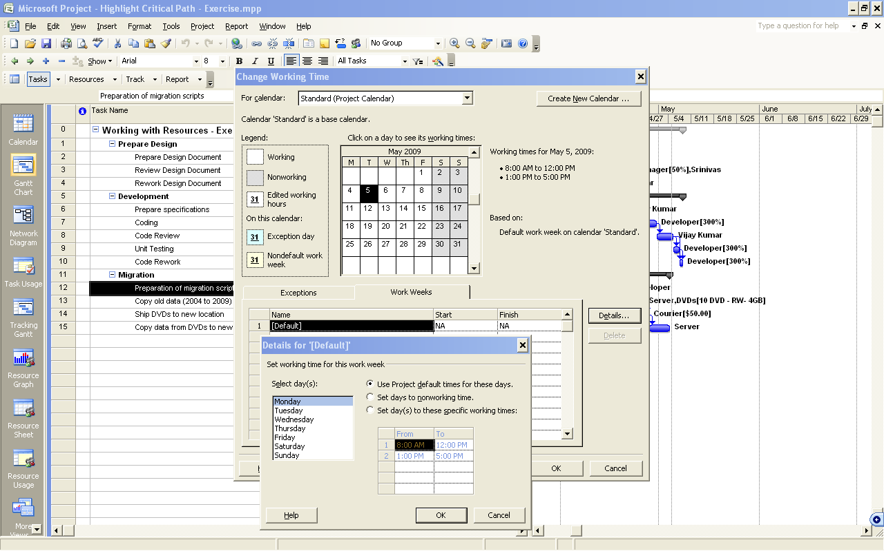
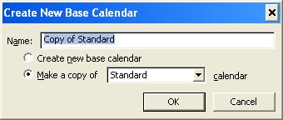
Creating a Task Calendar

Slide 17
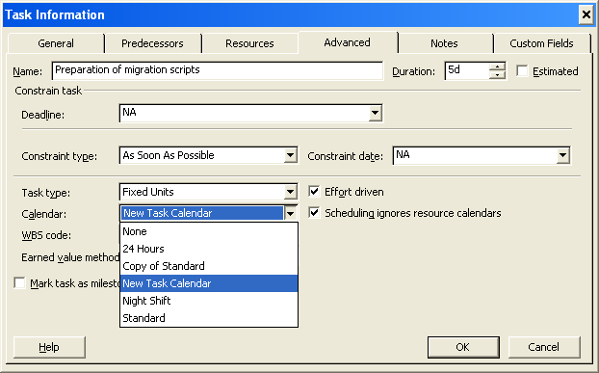
Applying the new Task Calendar

Slide 18
Creating a Task Calendar
To create a new task calendar, select Change Working Time on the Tools menu,.
To create a new base calendar, in the Change Working Time dialog box, click Create New Calendar.
To specify a name for the new calendar, type the name in Name box in the Create New Base Calendar dialog box
Ensure that the Make a copy of option is selected and select the required calendar in the list. click OK.
Now specify working time and days, click the Work Weeks tab, and then click Details.
To specify the working days for the task calendar, in the Details for ‘[Default]’ dialog box, in the Select day(s) list, select the working days for the task calendar.
Select the Set day(s) to these specific working times option to change working time for the selected days, in the Details for ‘[Default]’ dialog box.
Specify the required working hours, and click OK. You can delete or override default suggested time.
Click OK to return to the Gantt Chart view in the Change Working Time dialog box
To apply the new task calendar to a task, select the task to which you want to apply the new task calendar, and click the Task Information on the Standard toolbar.
Select Advanced tab and then select the new task calendar that you created in the Calendar list.
Select the Scheduling ignores resource calendars check box, and click OK.

Slide 19
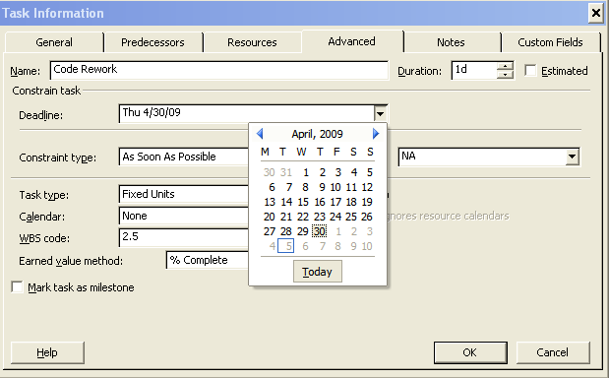
Setting Deadlines for a Task
If you want task to complete by a specific date, you can apply the MFO or FNLT constraint to the task. It will restrict flexibility in scheduling
If you want to set a target date, you can set a deadline date for the task along with the default constraint ASAP.
By setting a deadline date, you can track the target completion date without restricting rescheduling the end date if the task completes earlier or later than the deadline date.
If the end date moves past the deadline date, You can see an exclamation mark in a red diamond in the Indicators column for the task.

Slide 20
Setting Up Recurring Tasks
Certain tasks, such as conducting team meetings, conducting weekly status meetings, reporting project status are repetitive tasks and reoccur weekly or monthly or at certain interval. You can schedule a repetitive task by setting up a recurring task.
When you create a recurring task,
  The SNET task constraint is applied to the task.
  You cannot create a task relationship for a recurring task
  The default effort-driven scheduling is turned off
  The recurring task symbol appears in the Indicators column for the task
You will find, Project 2007 add a summary task with each instance as sub tasks adding a sequence number to task name
You can assign resources to the recurring summary task. Project 2007 assigns resources to each instance of the recurring task.

Slide 21
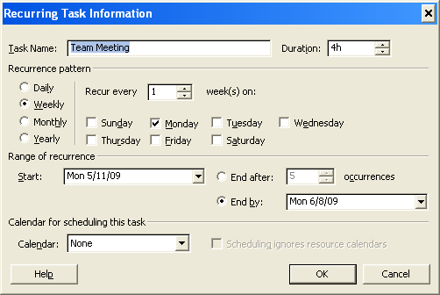
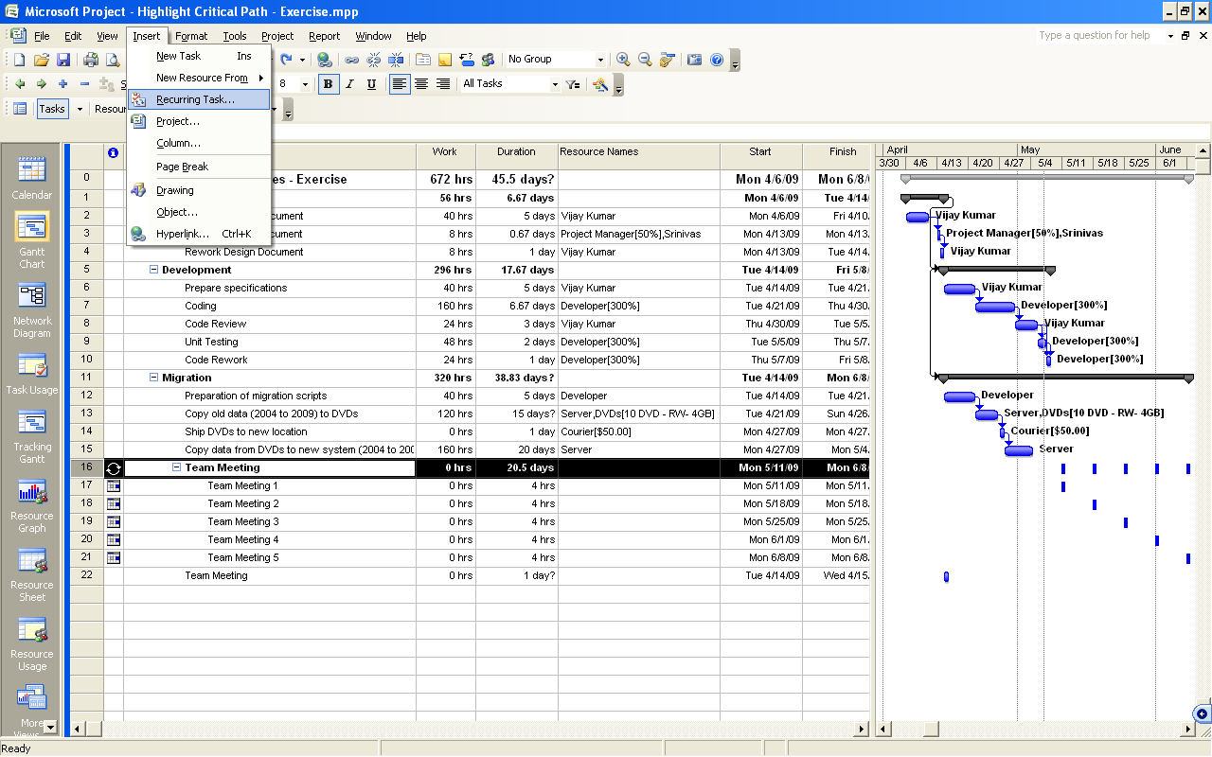
Setting Up Recurring Tasks

Slide 22
Splitting a Task
If you want to stop the work in middle and restart again later, you can split the task into portions.
When you click the Split Task button, the pointer changes and a ScreenTip appears on your project plan. When you move the pointer to the Gantt bar of the task that you want to split, the date on the ScreenTip changes, indicating the point at which the task will be split. When you click the point where you want to split the task, the Gantt bar is split into two parts that are separated by an interval of one day.
You can move the second portion of the task to the date that you want the part to begin.
You can also move the start date of the entire task, keeping the split intact, by dragging the first part to the location that you want.
To remove the split, drag one part until it touches the other part.
Steps
  Click Split Task on the Standard toolbar
  To position the pointer on the Gantt bar of the task that you want to split, move the pointer to the Gantt bar of the required task.
  To select the point where you want to split the task, on the Gantt bar of the task, click the appropriate point.
  To change the start date between the two parts, point the mouse to the second part and drag it to the date at which you want this second part to begin.
  To remove the split, click the second part, and then drag it until the bar touches the first part.

Slide 23

Questions
You want a task to be completed on a certain date. If the task is delayed, it will affect the project end date. Therefore, you want to reschedule the successor tasks and the project end date if the task is delayed. Which of the following methods will you apply to set up the task without affecting the flexibility in scheduling?
Select the one best answer.
  Apply the MFO constraint to ensure that the task finishes on the specified date
  Change the task type to Fixed Duration
  Set a deadline date for the task and apply the ASAP constraint
  Apply the FNLT constraint to ensure that the task finishes before or on the specified date
  ✓

Slide 24
Questions
Project metrics and status are to be sent every week to management. This is an hour job that need to be carried out every Friday. How do you set up this task?
Select the one best answer
  Schedule a fixed duration task to occur on every Friday throughout the life cycle of the project.
  Set up a recurring task to occur every Friday until the project end date.
  Schedule the task with the MSO constraint to ensure that the task is completed as scheduled.
  Schedule the task with the MFO constraint to ensure that the task is completed as scheduled
  ✓

Slide 25
LAB – Scenario
Northwind Traders is a multibrand discount retail outlet. It offers its customers a wide range of products at discounts from 25 percent to 60 percent throughout the year. As a discount retail outlet selling leading apparel and sportswear brands, the company operates on narrow margins. To streamline operation and improve efficiency, the company wants to develop an in-house application that helps manage inventory, sales, and human resources activities.
You are the Project Manager responsible for the application development project. You have created a basic project plan, and you now need to fine-tune the task details to reflect external project factors in the schedule.
You need to ensure that the project plan meets the following requirements:
    The external dependencies are accounted for in the project plan.
    Modifying the duration of a task does not affect the effort that is required to complete the task.
    The project end date is not affected when changes are made to the project plan.
    The project plan accommodates a resource who works on weekends.
    The design phase, an important milestone, completes on a specific date.
    Regular team meetings are scheduled

Slide 26
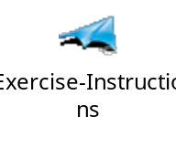
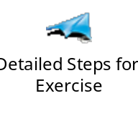
LAB – Exercise
In this lab, you will perform six exercises designed to help you achieve the learning objectives. All the six exercises are local labs.
Exercise 1: Specifying Task Constraints
In this exercise, you will change the default ASAP constraint of a task to the SNET constraint and observe its impact on the schedule.
Exercise 2: Changing Task Types
In this exercise, you will change the task type of a critical task so that there is no impact on work and schedule when you change the duration of the task.
Exercise 3: Identifying Tasks on the Critical Path
In this exercise, you will identify and view the critical tasks in the plan so that you can track them closely.
Exercise 4: Creating a New Task Calendar
In this exercise, you will create a separate task calendar for a resource and apply it to the task to which the resource is assigned.
Exercise 5: Setting a Deadline
In this exercise, you will set a deadline for achieving an important milestone.
Exercise 6: Setting Up a Recurring Task
In this exercise, you will set up weekly team meetings to occur frequently throughout the duration of the project

Slide 27
